Slide 1
ThE STATE OF THE INDUSTRY 2019
A presentation to leading brokerage leaders of the Kansas Association of Realtors
February 4, 2019

Slide 2
The state of the residential brokerage industry
In recent Harris Insights study (July 2018) recent buyers and sellers said:
90% used an agent when buying or selling – no differentiation between Millennials or Gen-x
69% said they still depended on a referral from a trusted source as the main way they found and selected an agent
89% said negotiation assistance the most valuable service followed by the “provision” of homes that fit my needs or were comparable to my home

Slide 3
The state of the residential brokerage industry
REAL Trends ranking of top agents and teams for calendar 2017 and published in July 2018 showed
15,500 total agents and teams est. 1.2% of all Realtors® in country
Did 11% of all the closed sides in the country
Did 22% of all closed volume in the country

Slide 4
The state of the residential brokerage industry
Existing home sales have declined on an annual basis in 6 of last 7 months - new home sales are flat with last year and have declined in 2 or last 3 months
Year over year price increases are flattening
Inventory shortages are easing somewhat but still critically short in entry levels across the country

Slide 5
The state of the residential brokerage industry
New forms of competition have multiplied and in some cases gaining strength
Many increase the cost of employing agents and teams
Compass, eXp, REAL, Keller Williams, HomeSmart, Realty One Group, and other local privately owned firms

Slide 6
The state of the residential brokerage industry
Due to the extreme competitive environment, brokerage gross and net margins are facing downward pressure
Pressure from growth of teams and average size of teams is also putting downward pressure on brokerage margins
Cyclical pressures are building in core service margins, such as in mortgage, title insurance and other related realty service industries

Slide 7
The Age of the Disruptor
The brokerage disruptors – eXp, Compass, Realty One Group, JP and Associates etc.
The consumer disruptors – Open Door, Offer Pad, Knock.com, Ribbons
Old age disruptors – RE/MAX, Merril Lynch, Sears, Keller Williams, Realogy

Slide 8
Summary points
The brokerage market is forcing firms to either be “unique” or “cheap” that is either specialized small market share boutiques or large low cost (to agents) firms with related core services
Put another way do you prefer to be a Nordstrom or a Wal Mart?
This is not a new trend – it started 40 years ago – but increased number of low cost competitors is driving trend faster than ever before

Slide 9
Some data to share
These are slides prepared from financial and operating data from 300+ brokerage firms of all models, brands, sizes and locations in the U.S. from 2017 and 2018 by REAL Trends

Slide 13
1991 | 6.10%
1992 | 6.04%
1993 | 5.94%
1994 | 5.88%
1995 | 5.83%
1996 | 5.75%
1997 | 5.64%
1998 | 5.48%
1999 | 5.44%
2000 | 5.42%
2001 | 5.12%
2002 | 5.14%
2003 | 5.12%
2004 | 5.08%
2005 | 5.02%
2006 | 5.18%
2007 | 5.28%
2008 | 5.34%
2009 | 5.38%
2010 | 5.40%
2011 | 5.30%
2012 | 5.40%
2013 | 5.38%
2014 | 5.18%
2015 | 5.26%
2016 | 5.12%
2017 | 5.08%
RT 500 Average Commission Rate 5.08% lowest since 2005

Slide 14
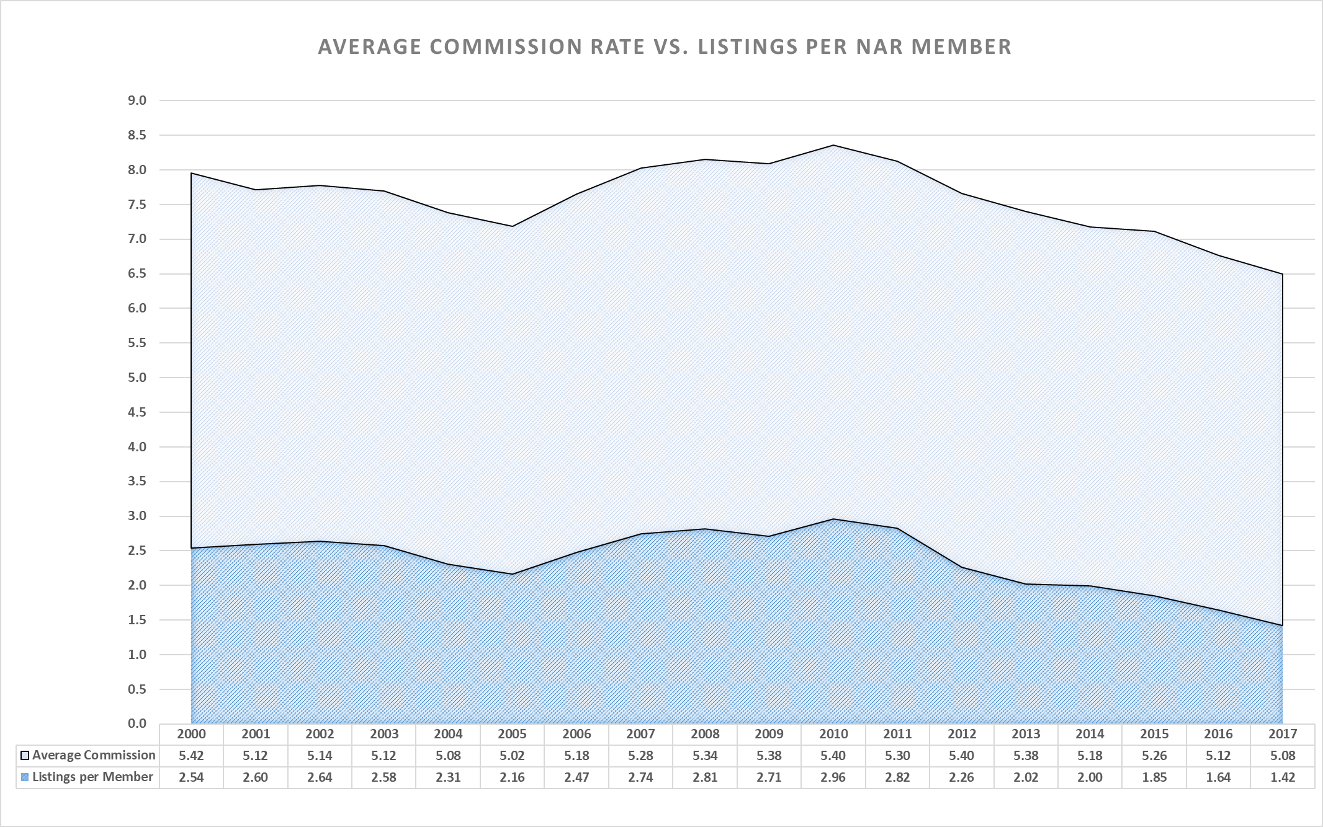

Slide 15
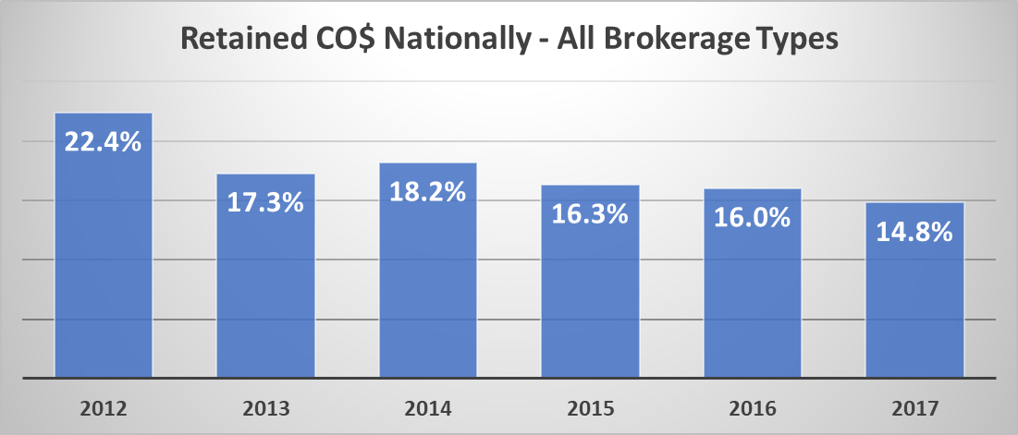

Slide 16
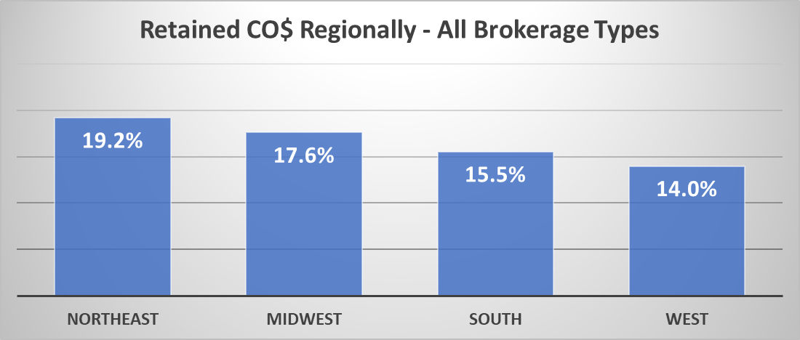

Slide 17
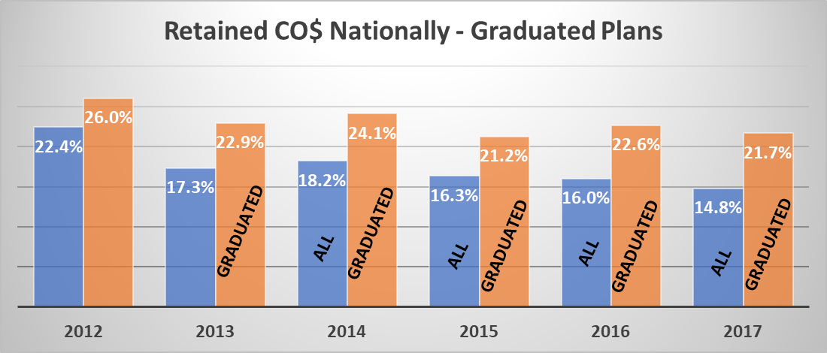

Slide 18
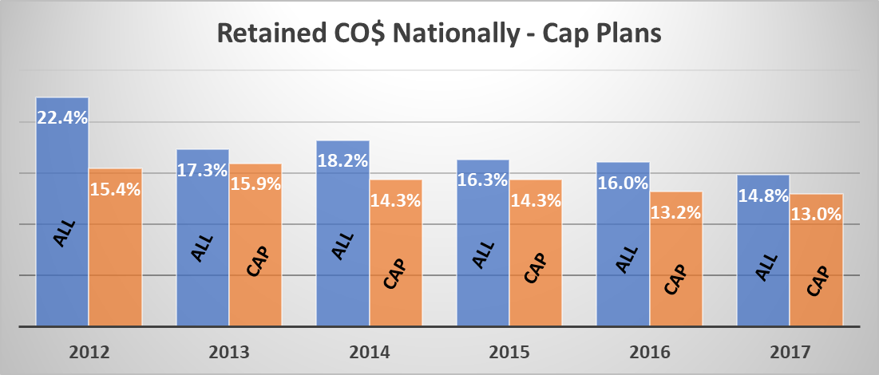

Slide 19
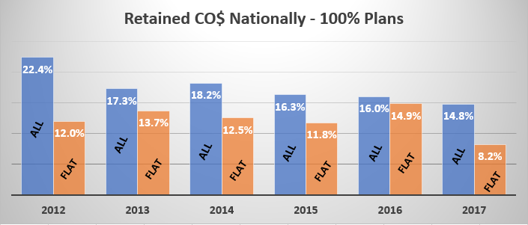

Slide 20
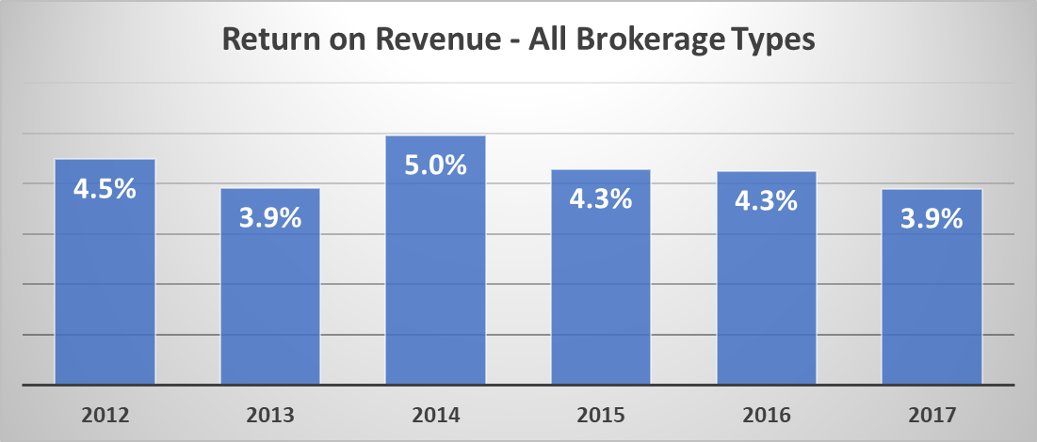

Slide 21
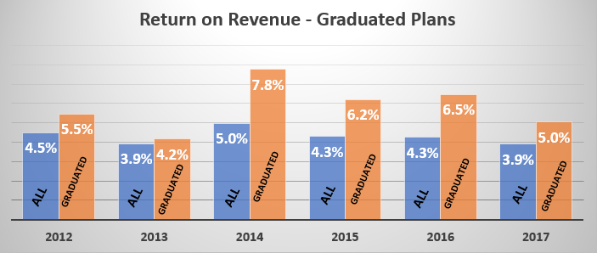

Slide 22
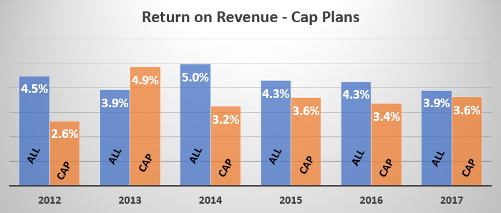

Slide 23
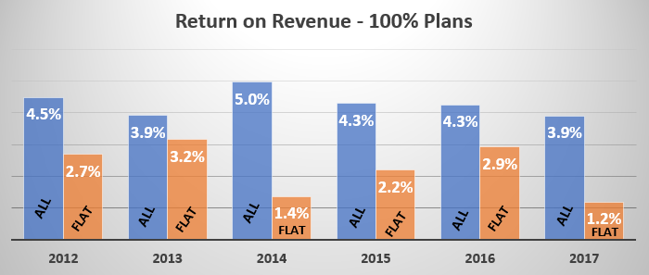

Slide 24
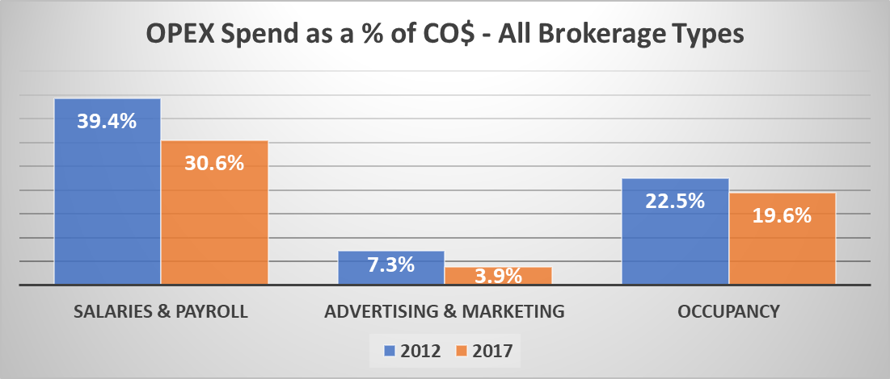

Slide 25
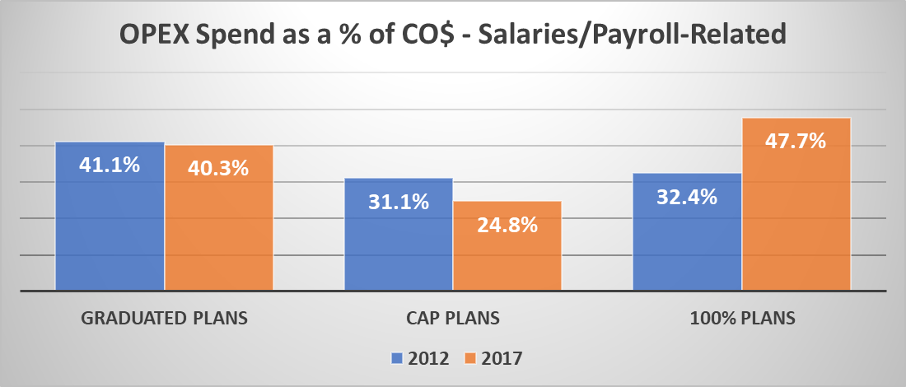

Slide 26
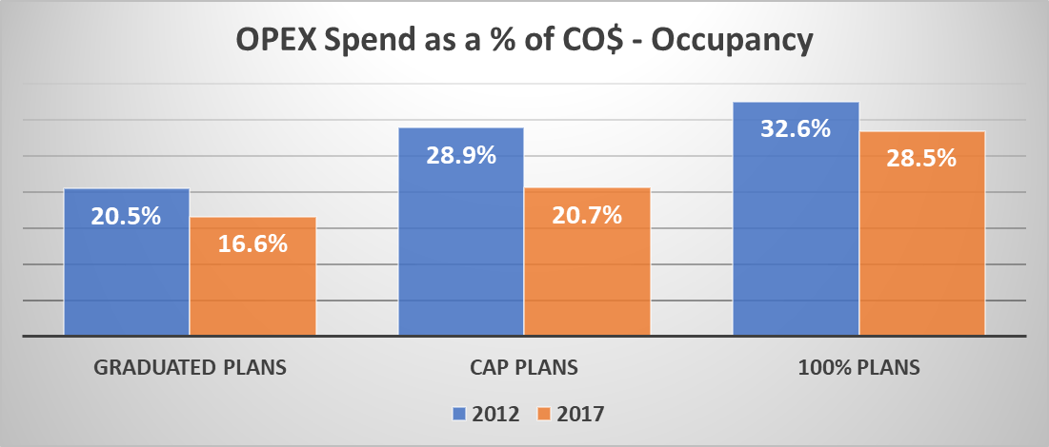

Slide 27
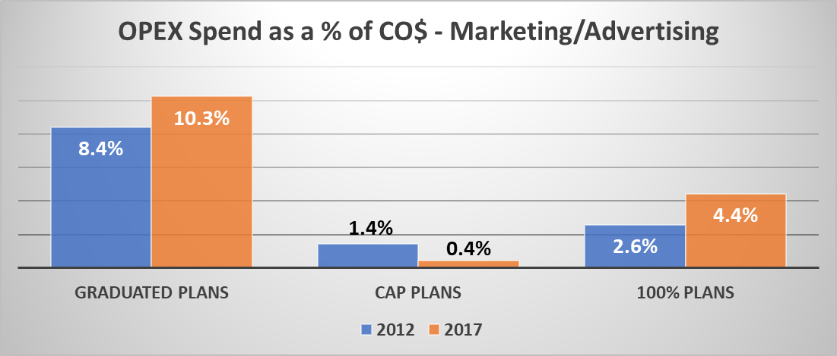

Slide 28
Valuation of residential brokerage firms
We are at the tail end of a boom in the market valuation of residential brokerage firms
Realogy/NRT is no longer buying brokerage firms
Berkshire Hathaway HomeServices has indicated that it will slow its acquisitions and reduce its price and terms
However there is great activity remaining but mostly among local or regional competitors
Some investor activity is present at this time

Slide 29
Valuation of residential brokerage firms
Valuation is still based on trailing 12 months EBITDA (earnings before interest, taxes, depreciation and amortization)
Multiples vary depending on size of firm, model of firm, location and size of market, availability of purchasers and brand restrictions
2.5 at low end 5.5 at upper end
Final prices almost always affected by the Terms of a Transaction

Slide 30
Valuation of residential brokerage firms
Profit is the most powerful indicator of value
Brokerage’s that show increases in agent count, productivity and other factors create an opportunity for higher prices
Related core services such as mortgage, title insurance and property management are generally valued at prices similar to that of the brokerage firm

Slide 31
The Impact of Technology
Current thinking among many new leaders
Tech will make the difference between winners and losers
Tech will ultimately replace real estate brokers and agents
Tech will enable smarter agents and brokers through predictive analytics
Tech will enable higher levels of productivity
Tech will make the consumer experience much better
Tech will enable iBuyers to significantly impact markets

Slide 32
Impact of technology
There is simply no current proof that any of these future thoughts will actually happen – with some notable exceptions
Tech does enable great agents and teams to both market and deliver service more efficiently
Tech will provide an opportunity for consumers to gain more insights into markets and processes
And It will enable iBuyers to work very efficiently

Slide 33
Some conclusions
The brokerage industry has undergone several different waves of restructuring over the past 40 years – mostly based on lower cost brokerage options. This period is yet another
The advent of teams is an entirely new form of business, but actually resembles brokerage firms of 50-60 years ago
The desire to access and utilize brokerage services remains undiminished

Slide 34
Five Steps to Increasing Value
The five steps in increasing value
What are your reasons for owning your firm: Income, Equity or Satisfaction
What do you believe in about your business?
Understanding the fundamental truths about a brokerage firm

Slide 35
Five Steps to Increasing Value
Stop chasing technology
Focus scarce resources on productive activities

Slide 36
Reasons for owning a brokerage
Income, Equity or Satisfaction – which is the most important to you
You cannot build a successful brokerage without having a firm answer to this question – for you cannot develop plans without knowing the answer
It is of course portions of all three – but one must take precedent over the others

Slide 37
Reasons for owning a brokerage
The “Why” you own a brokerage comes first, then you develop your strategy to accomplish that
Tactics follow strategy not the other way around

Slide 38
What do you believe in?
What do you believe in about yourself? What kind of brokerage do you want to have?
The largest
The most productive
The most profitable
Dominant in a niche or specialty

Slide 39
What do you believe in?
What are your strengths as a leader? As an operator?
What behaviors to you find most appealing in residential real estate brokers or sales agents?
Do you desire to be the Nordstrom's? Wal Mart? Target?

Slide 40
Fundamental truths about brokerage firms
There are few, if any, sustainable competitive advantages available to residential brokerage firms – not in technology, marketing or education
There are three basics to owning a residential brokerage firm that will cause continual success

Slide 41
Fundamental truths about brokerage firms
You must have an ability to recruit talent to your firm
You must have the ability to develop and align that talent
You must spend less money to do these two things than you have coming in

Slide 42
Recruiting talent
What type of talent do you have now?
How many others in your market fit that profile?
What plan (real plan) do you have for building relationships with those that fit that profile?

Slide 43
Developing talent
What programs, tools or services do you have that specifically address increasing the productivity of your sales professionals?
Same question for your employees?
How are you measuring your success in these areas? Without a way to measure success, it will likely never happen

Slide 44
Spend less money than you have coming in
Fundamental to business is to make a profit – it is the cost you have of staying in business
What areas are you spending money on that does not DIRECTLY affect recruiting or developing productivity?
Where can you invest that will bring $2 in for every $1 you spend?

Slide 45
Stop chasing technology
Thus far in the technological evolution there is not one shred of evidence that brokerage firms with the better tech platforms are more productive or more profitable (Think RedFin)
Most leaders in this area admit that getting 25-35% adoption of any tech tool is an amazing feat. In fact that is about the percentage of agents in almost all leading brokerage firms who do 80+ percent of all the business (why would someone doing 2 or fewer deals a year need advanced technology anyway?)

Slide 46
Stop chasing technology
Firms that are using technology most effectively are using it to attract consumers (web sites and online marketing) and delivering those consumers to their agents (lead generation)
And the tools to accomplish these key objectives are plentiful, as are tools for Transaction Management (TM) and Customer Relationship Management (CRM). But differing TM and CRM systems will not make a substantial difference for your business

Slide 47
Strong branding is not the most important factor in the success of brokerage firms
The mere presence of a strong national brand in your offering is not a guarantee of the performance of your firm – great brand without solid leadership will not produce results
How do you fit your strong brand into the narrative of your discussion with potential recruits and with your own existing agents?

Slide 48
Other steps
Inside revenue sources
Tech fees
Marketing fees
Risk Management fees
Transaction fees

Slide 49
Other steps
Outside revenue sources
Mortgage
Escrow
Title insurance or other settlement services
Consumer fees
Property Management fees

Slide 50
Finally
The ability to create value in brokerage is almost entirely due to the vision and focus of the leader and the leadership team
What you focus on can become a reality (Ninja Mastery)
Without the recruitment and development of talent, brokerage will be a difficult challenge

